Slide 1

Chapter 7:
Project Cost Management
Information Technology Project Management, Seventh Edition
Note: See the text itself for full citations.

Slide 2
讨论问题
1、项目成本管理的4个过程
2、成本管理计划应该包括哪些信息？
3、三种基本的成本估算类型
4、成本估算的工具和技术有哪些？
5、挣值公式（EV, CV, SV, CPI, SPI）

Slide 3
Learning Objectives
Understand the importance of project cost management
Explain basic project cost management principles, concepts, and terms
Describe the process of planning cost management
Discuss different types of cost estimates and methods for preparing them

Slide 4
Learning Objectives
Understand the processes of determining a budget and preparing a cost estimate for an information technology (IT) project
Understand the benefits of earned value management and project portfolio management to assist in cost control
Describe how project management software can assist in project cost management

Slide 5
The Importance of Project Cost Management
IT projects have a poor track record for meeting budget goals
The CHAOS studies found the average cost overrun (the additional percentage or dollar amount by which actual costs exceed estimates) ranged from 180 percent in 1994 to 43 percent in 2010
A 2011 Harvard Business Review study reported an average cost overrun of 27 percent. The most important finding was the discovery of a large number of gigantic overages or “black swans”

Slide 6
What Went Wrong?
The U.S. government, especially the IRS, continues to provide examples of how not to manage costs
  A series of project failures by the IRS in the 1990s cost taxpayers more than $50 billion a year
  In 2006, the IRS was in the news for a botched upgrade to its fraud-detection software, costing $318 million in fraudulent refunds that didn’t get caught
  A 2008 Government Accountability Office (GAO) report stated that more than 400 U.S. government agency IT projects, worth an estimated $25 billion, suffer from poor planning and underperformance
The United Kingdom’s National Health Service IT modernization program was called the greatest IT disaster in history with an estimated $26 billion overrun. It was finally scrapped in 2011.

Slide 7
What is Cost and Project Cost Management?
Cost is a resource sacrificed or foregone to achieve a specific objective or something given up in exchange
Costs are usually measured in monetary units like dollars
Project cost management includes the processes required to ensure that the project is completed within an approved budget

Slide 8
Project Cost Management Processes
Planning cost management :determining the policies, procedures, and documentation that will be used for planning, executing, and controlling project cost.
Estimating costs: developing an approximation or estimate of the costs of the resources needed to complete a project
Determining the budget: allocating the overall cost estimate to individual work items to establish a baseline for measuring performance
Controlling costs: controlling changes to the project budget

Slide 9
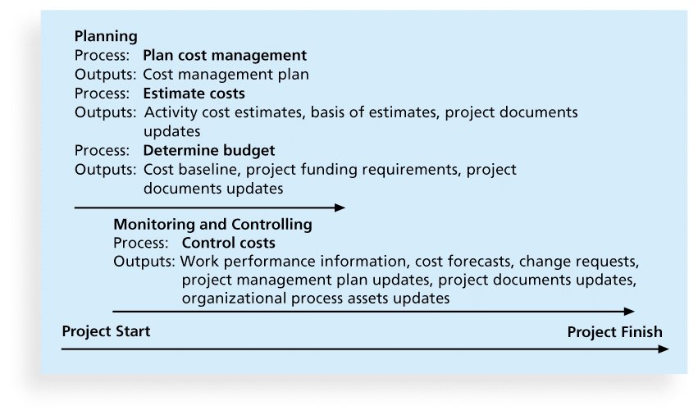
Figure 7-1. Project Cost Management Summary

Slide 10
Basic Principles of Cost Management
Most members of an executive board better understand and are more interested in financial terms than IT terms , so IT project managers must speak their language
  Profits are revenues minus expenditures
  Profit margin is the ratio of revenues to profits
  Life cycle costing considers the total cost of ownership, or development plus support costs, for a project
  Cash flow analysis determines the estimated annual costs and benefits for a project and the resulting annual cash flow

Slide 11
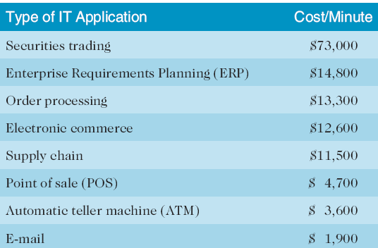
Table 7-1. Cost of Downtime for IT Applications
Source: The Standish Group International, “Trends in IT Value,” www.standishgroup.com (2008).

Slide 12
What Went Right?
Many organizations use IT to reduce operational costs
Technology has decreased the costs associated with processing an ATM transaction:
  In 1968, the average cost was $5.
  In 1978, the cost went down to $1.50
  In 1988, the cost was just a nickel.
  In 1998, it only cost a penny.
  In 2008, the cost was just half a penny!
Investing in green IT and other initiatives has helped both the environment and companies’ bottom lines. Michael Dell, CEO of Dell, reached his goal to make his company “carbon neutral” in 2008. As of March 2012, Dell had helped its customers save almost $7 billion in energy costs

Slide 13
Types of Costs and Benefits
Tangible costs or benefits are those costs or benefits that an organization can easily measure in dollars
Intangible costs or benefits are costs or benefits that are difficult to measure in monetary terms
Direct costs are costs that can be directly related to producing the products and services of the project
Indirect costs are costs that are not directly related to the products or services of the project, but are indirectly related to performing the project
Sunk cost is money that has been spent in the past; when deciding what projects to invest in or continue, you should not include sunk costs

Slide 14
More Basic Principles of Cost Management
Learning curve theory states that when many items are produced repetitively, the unit cost of those items decreases in a regular pattern as more units are produced
Reserves are dollars included in a cost estimate to mitigate cost risk by allowing for future situations that are difficult to predict
  Contingency reserves allow for future situations that may be partially planned for (sometimes called known unknowns) and are included in the project cost baseline
  Management reserves allow for future situations that are unpredictable (sometimes called unknown unknowns

Slide 15
Planning Cost Management
The project team uses expert judgment, analytical techniques, and meetings to develop the cost management plan
A cost management plan includes:
  Level of accuracy and units of measure
  Organizational procedure links
  Control thresholds
  Rules of performance measurement
  Reporting formats
  Process descriptions

Slide 16
Estimating Costs
Project managers must take cost estimates seriously if they want to complete projects within budget constraints
It’s important to know the types of cost estimates, how to prepare cost estimates, and typical problems associated with IT cost estimates

Slide 17
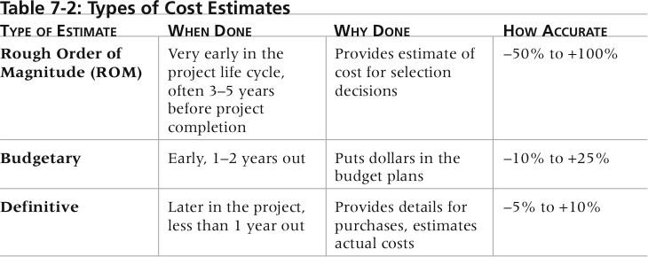
Table 7-2. Types of Cost Estimates

Slide 18
More on Cost Estimates
The number and type of cost estimates vary by application area. The Association for the Advancement of Cost Engineering International identifies five types of cost estimates for construction projects: order of magnitude, conceptual, preliminary, definitive, and control
Estimates are usually done at various stages of a project and should become more accurate as time progresses
A large percentage of total project costs are often labor costs

Slide 19
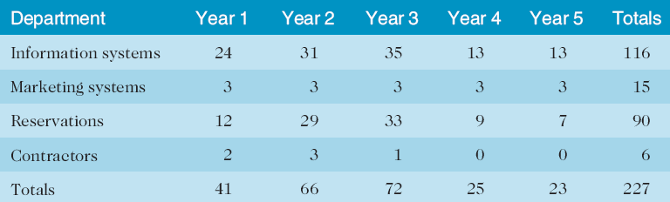
Table 7-3. Maximum FTE by Department by Year

Slide 20
Cost Estimation Tools and Techniques
Basic tools and techniques for cost estimates:
  Analogous or top-down estimates: use the actual cost of a previous, similar project as the basis for estimating the cost of the current project
  Bottom-up estimates: involve estimating individual work items or activities and summing them to get a project total
  Parametric modeling uses project characteristics (parameters) in a mathematical model to estimate project costs

Slide 21
Typical Problems with IT Cost Estimates
Estimates are done too quickly
People lack estimating experience
Human beings are biased toward underestimation
Management desires accuracy

Slide 22
Sample Cost Estimate
See pages 284-289 for a detailed example of creating a cost estimate for the Surveyor Pro project described in the opening case
Before creating an estimate, know what it will be used for, gather as much information as possible, and clarify the ground rules and assumptions for the estimate
If possible, estimate costs by major WBS categories
Create a cost model to make it easy to make changes to and document the estimate

Slide 23
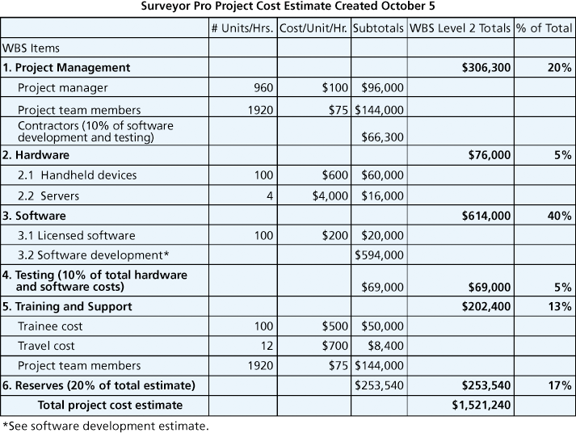
Figure 7-2. Surveyor Pro Project Cost Estimate

Slide 24
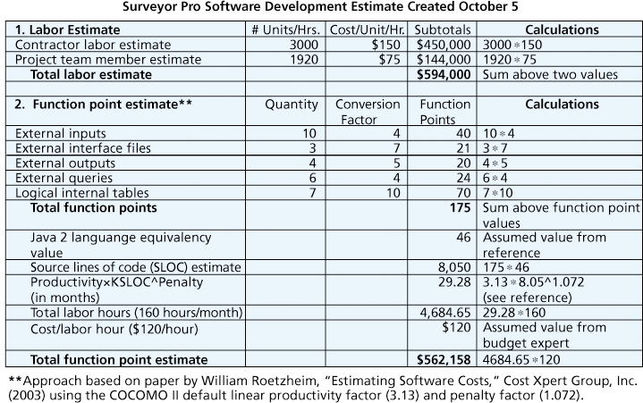
Figure 7-3. Surveyor Pro Software Development Estimate

Slide 25
Determining the Budget
Cost budgeting involves allocating the project cost estimate to individual work items over time
The WBS is a required input to the cost budgeting process since it defines the work items
Important goal is to produce a cost baseline
  a time-phased budget that project managers use to measure and monitor cost performance

Slide 26
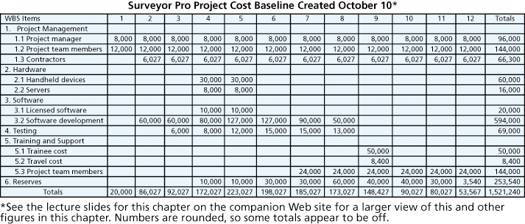
Figure 7-4. Surveyor Pro Project Cost Baseline

Slide 27
Media Snapshot
U.S. President Barack Obama successfully used the media and information technology in his campaign
  The Obama campaign used 16 different online social platforms to interact with people of various backgrounds; sources say 80 percent of all contributions originated from these social networks
  In a 60 Minutes episode shortly after the election, campaign leaders discussed some of the details of the campaign
  The Web site My.BarackObama was created to develop an online community with over a million members

Slide 28
Controlling Costs
Project cost control includes
  Monitoring cost performance
  Ensuring that only appropriate project changes are included in a revised cost baseline
  Informing project stakeholders of authorized changes to the project that will affect costs
Many organizations around the globe have problems with cost control

Slide 29
Earned Value Management (EVM)
EVM is a project performance measurement technique that integrates scope, time, and cost data
Given a baseline (original plan plus approved changes), you can determine how well the project is meeting its goals
You must enter actual information periodically to use EVM
More and more organizations around the world are using EVM to help control project costs

Slide 30
Earned Value Management Terms
The planned value (PV), formerly called the budgeted cost of work scheduled (BCWS), also called the budget, is that portion of the approved total cost estimate planned to be spent on an activity during a given period
Actual cost (AC), formerly called actual cost of work performed (ACWP), is the total of direct and indirect costs incurred in accomplishing work on an activity during a given period
The earned value (EV), formerly called the budgeted cost of work performed (BCWP), is an estimate of the value of the physical work actually completed
EV is based on the original planned costs for the project or activity and the rate at which the team is completing work on the project or activity to date

Slide 31
Rate of Performance
Rate of performance (RP) is the ratio of actual work completed to the percentage of work planned to have been completed at any given time during the life of the project or activity
Brenda Taylor, Senior Project Manager in South Africa, suggests this term and approach for estimating earned value
For example, suppose the server installation was halfway completed by the end of week 1. The rate of performance would be 50% because by the end of week 1, the planned schedule reflects that the task should be 100 percent complete and only 50 percent of that work has been completed

Slide 32
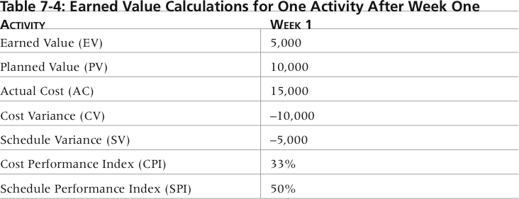
Table 7-4. Earned Value Calculations for One Activity After Week One

Slide 33
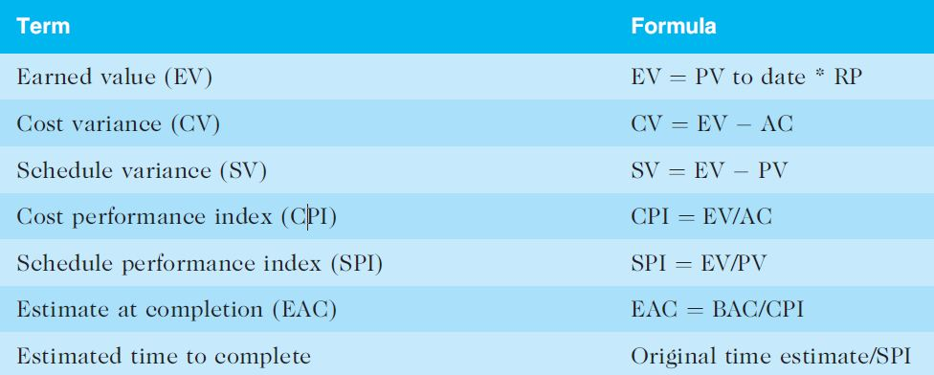
Table 7-5. Earned Value Formulas

Slide 34
Rules of Thumb for Earned Value Numbers
Negative numbers for cost and schedule variance indicate problems in those areas
CPI and SPI less than 100% indicate problems
  CPI-费用执行指标(Cost Performed Index), CPI是指挣得值与实际费用值之比。CPI=BCWP／ACWP。当 CPI＞1表示低于预算，CPI＜1表示超出预算，CPI＝1表示实际费用与预算费用吻合。若CPI=1,表明项目费用按计划进行。
  SPI-进度执行指标(Schedule Performed Index-SPI)：SPI是指项目挣得值与计划值之比，即SPI=BCWP／BCWS，当 SPI＞1表示进度提前，SPI＜1表示进度延误，SPI＝1表示实际进度等于计划进度。

Slide 35
Problems mean the project is costing more than planned (over budget) or taking longer than planned (behind schedule)
The CPI can be used to calculate the estimate at completion (EAC)—an estimate of what it will cost to complete the project based on performance to date. The budget at completion (BAC) is the original total budget for the project

Slide 36
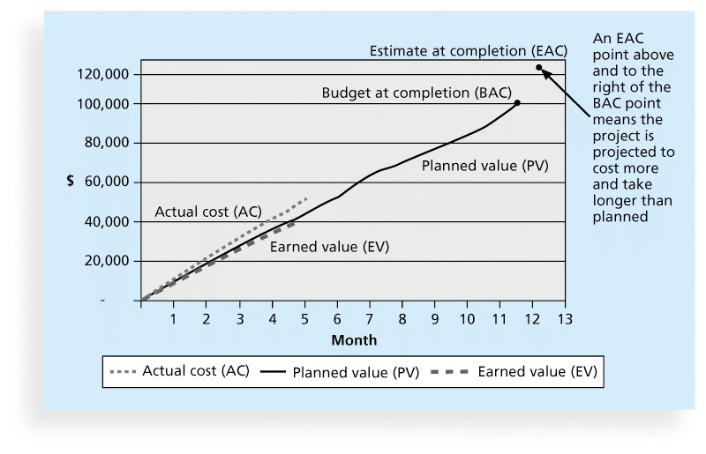
Figure 7-5. Earned Value Chart for Project after Five Months

Slide 37
Global Issues
EVM is used worldwide, and it is particularly popular in the Middle East, South Asia, Canada, and Europe
Most countries require EVM for large defense or government projects, as shown in Figure 7-6
EVM is also used in such private-industry sectors as IT, construction, energy, and manufacturing.
However, most private companies have not yet applied EVM to their projects because management does not require it, feeling it is too complex and not cost effective

Slide 38
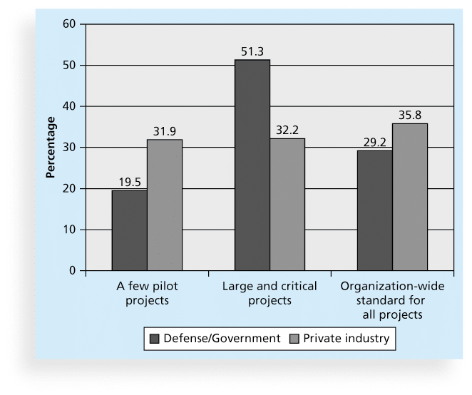
Figure 7-6. Earned Value Usage

Slide 39
Project Portfolio Management
Many organizations collect and control an entire suite of projects or investments as one set of interrelated activities in a portfolio
Five levels for project portfolio management
  Put all your projects in one database
  Prioritize the projects in your database
  Divide your projects into two or three budgets based on type of investment
  Automate the repository
  Apply modern portfolio theory, including risk-return tools that map project risk on a curve

Slide 40
Benefits of Portfolio Management
Schlumberger saved $3 million in one year by organizing 120 information technology projects into a portfolio
ROI of implementing portfolio management software by IT departments:
  Savings of 6.5 percent of the average annual IT budget by the end of year one
  Improved annual average project timeliness by 45.2 percent
  Reduced IT management time spent on project status reporting by 43 percent and IT labor capitalization reporting by 55 percent
  Decreased the time to achieve financial sign-off for new IT projects by 20.4 percent, or 8.4 days

Slide 41
Best Practice
A global survey released by Borland Software in 2006 suggests that many organizations are still at a low-level of maturity in terms of how they define project goals, allocate resources, and measure overall success of their information technology portfolios. Some of the findings include the following:
  Only 22 percent of survey respondents reported that their organization either effectively or very effectively uses a project plan for managing projects
  Only 17 percent have either rigorous or very rigorous processes for project plans, which include developing a baseline and estimating schedule, cost, and business impact of projects
  Only 20 percent agreed their organizations monitor portfolio progress and coordinate across inter-dependent projects

Slide 42
Using Software to Assist in Cost Management
Spreadsheets are a common tool for resource planning, cost estimating, cost budgeting, and cost control
Many companies use more sophisticated and centralized financial applications software for cost information
Project management software has many cost-related features, especially enterprise PM software
Portfolio management software can help reduce costs

Slide 43
Chapter Summary
Project cost management is a traditionally weak area of IT projects, and project managers must work to improve their ability to deliver projects within approved budgets
Main processes include
  Plan cost management
  Estimate costs
  Determine the budget
  Control costs

Slide 44
练习
1、会计师通常将___定义为达到一个特定的目的而牺牲或放弃的资源。
A.钱
B.责任
C.贸易
D.成本
‎2、什么是项目成本管理的主要目标？
A.用尽量低的成本完成一个项目
B.用一个批准的预算完成一个项目
C.提供真实、准确的项目成本信息
D.确保一个组织的钱使用得当

Slide 45
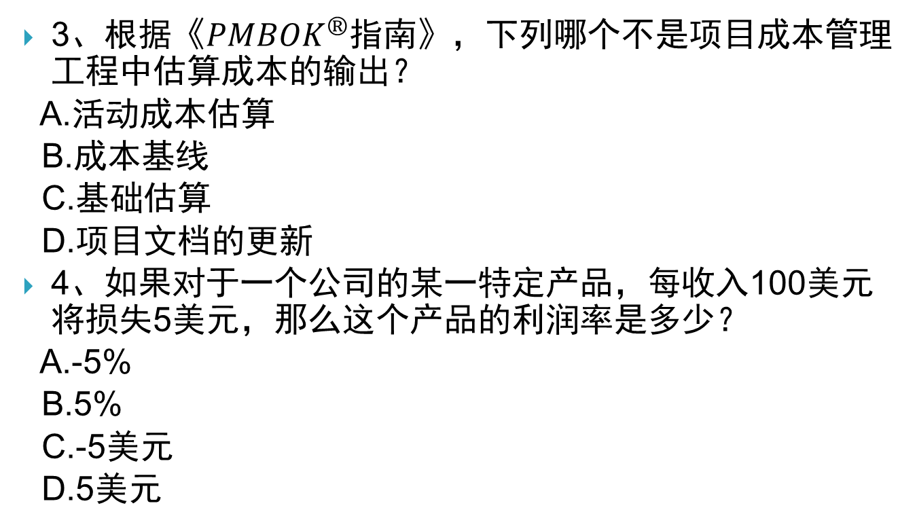
练习
3、根据《${PMBOK}^{®}$指南》，下列哪个不是项目成本管理工程中估算成本的输出？
A.活动成本估算
B.成本基线
C.基础估算
D.项目文档的更新
‎4、如果对于一个公司的某一特定产品，每收入100美元将损失5美元，那么这个产品的利润率是多少？
A.-5%
B.5%
C.-5美元
D.5美元

Slide 46
练习
5、___储备金允许未来的情况是不可预测的。
A.应急
B.金融
C.管理
D.基线
6、你准备为一个建筑做成本估算，可以基于它的位置、用途、平方米和其他特征。你将使用哪种成本估算方法？
A.参数
B.类似
C.自上而下
D.自下而上

Slide 47
练习
7、随着时间的推移，___涉及分配个人物质资源或工作项目的成本估计。
A.储备分析
B.生命周期成本计算
C.项目成本预算
D.挣值分析
8、___是一个项目的性能测量技术集成的范围、时间和成本数据。
A.储备分析
B.生命周期成本计算
C.项目成本预算
D.挣值管理

Slide 48
练习
9、如果一个WBS项目的实际成本是1500美元，它的挣值是2000美元，它的成本差异是什么？低于还是超过预算？
A.成本差异是-500美元，超过预算
B.成本差异是-500美元，在预算之内
C.成本差异是500美元，超过预算
D.成本差异是500美元，在预算之内
10、如果一个项目完成一半，其进度性能指数是110%，而它的成本性能指数是95%，它是如何发展的？
A.它是提前完成，在预算之内
B.它是提前完成，超过了预算
C.它是落后于预定计划，在预算之内
D.它是落后于预定计划，超过了预算

Slide 49
讨论问题
1、项目成本管理的4个过程
2、成本管理计划应该包括哪些信息？
3、三种基本的成本估算类型
4、成本估算的工具和技术有哪些？
5、挣值公式（EV, CV, SV, CPI, SPI）

Slide 50
讨论问题
1、项目成本管理的4个过程
计划成本管理
成本估算
确定预算
成本控制

Slide 51
讨论问题
2、成本管理计划应该包括哪些信息？
精确度
测量单位
组织程序链接
控制临界值
绩效测量规划
报告模板
过程描述

Slide 52
讨论问题
3、三种基本的成本估算类型
粗粒度估算
预算估算
确定性估算

Slide 53
讨论问题
4、成本估算的工具和技术有哪些？
类比估算（自上而下估算）
自下而上估算
三点估算
参数估算

Slide 54
讨论问题
5、挣值公式（EV, CV, SV, CPI, SPI）

